Slide 1

A-Frame-mazing Architecture

Slide 2
Ken Bonny
Architect
Analyst
Team lead
Coach
Developer
Notes:
Winner of buzzword-bingo

Slide 3
Agenda
A-Frame architecture
A project
A minimal example
A framework to help lift the load
A complex example
An external system interaction
A test
An ending

Slide 4
A-Frame Architecture
Controller
Infrastructure
Logic
Notes:
This is an architectural pattern
Pairs well with modular monolith or vertical slice architectures

Slide 5
Infrastructure
Anything that is non-deterministic
Database calls
Network
File systems
Date & time
Configuration & environment variables
Random number generators
…
Mostly external systems
Observable
Notes:
Create separate classes for these systems to encapsulate them
No need for abstractions as the separation from logic takes care of this, keep it simple and straightforward (KISS)
Do use available frameworks and libraries to help with this
IOptions and TimeProvider from dotnet springs to mind
Do add observability, preferably through OpenTelemetry

Slide 6
Logic
Data as input
Avoid infrastructure
Do use side-effect free libraries
Outputs decisions
Pure
Notes:
Also known as business logic, but I prefer the more generic term
For example: Watermark service (inject or new it up), feed it picture, get picture with watermark back, no side effects
Easy for testing, check that the watermark service works nicely
Does that make tests brittle, yes but in a good way. When changing a service, you immediately know where it breaks
When enough tests break, should you reuse or should you duplicate because it’s something else
Lastly, return decisions: save this to disk, update this in the db, notify these external systems, put these messages on the bus, etc.
Logic should be pure, look up this functional programming paradigm

Slide 7
Controller
Passes information between the others
Makes sure they don’t meet
In practice:
API endpoint
Message handler
WPF binding
Cronjob entry
Azure Function

Slide 8
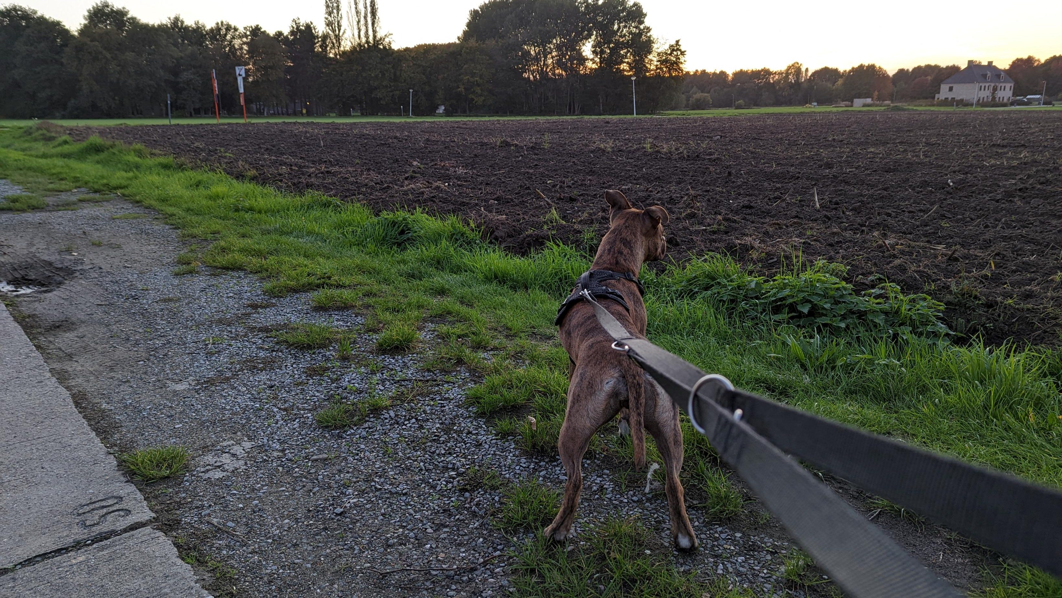
Project
Notes:
Dog walking app to see which friends we meet
Simple app, unfinished
Gloss over “details” such as entity framework setup
Showcase of techniques
Accept pull requests

Slide 9
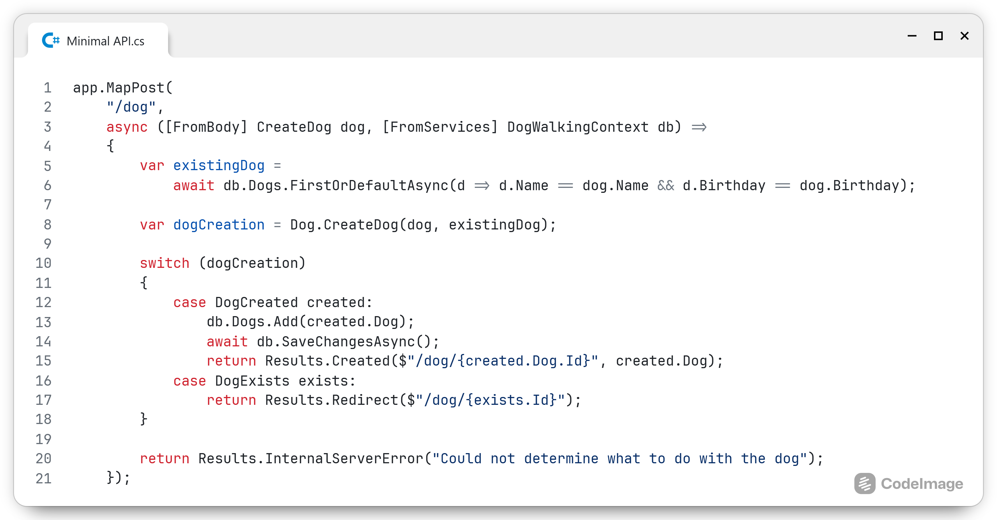
Notes:
Using minimal API, I’ve created a controller, called the infra, called the logic and handled the decisions of the logic in infra again
I would not put infrastructure code directly into my controller, a DbContext hides the implementation so I’m fine with that
If I would need to access the file system or network or date&time, I would use abstractions or classes that encapsulate that code

Slide 10
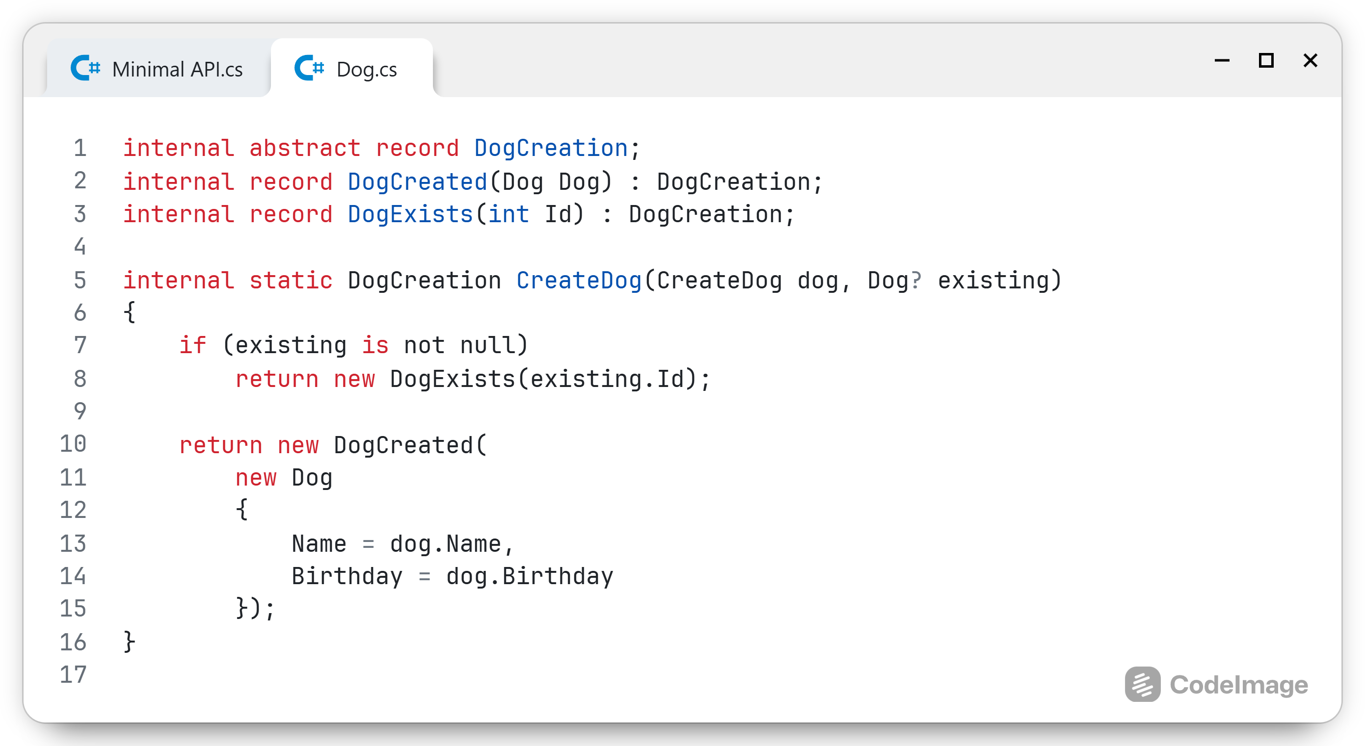
Notes:
The logic is quite straightforward and easy, just decide whether to create a new dog or refer to an existing one
The return object is the closest I can get to a Discriminated union
This might be a bit simplistic, but it conveys the power of the architecture

Slide 11

Notes:
It’s important to find the right balance between
Abstractions
Classes
More abstraction is more flexible
More flexible code is harder to read and maintain
This is different for each team
You’ll only find it through careful experimentation
I prefer to write and use classes
I’ll add abstractions or generalisations later when I see them emerge from my code

Slide 12
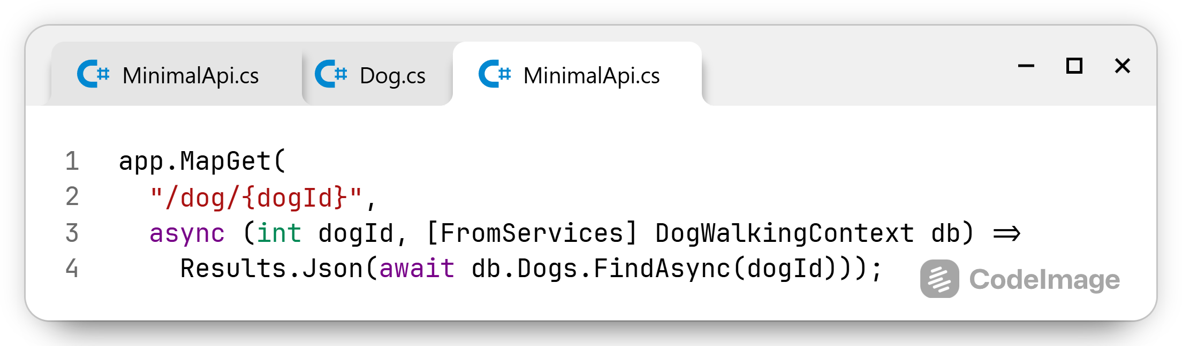
Simplify where you can
Notes:
Sometimes it’s all just infrastructure
Queries are a good example of this
Even the more complex search queries, I would just write directly in my endpoint and be done with it
There are always exceptions to the rule, but queries tend to be quite unique, so I don’t try to generalise them

Slide 13
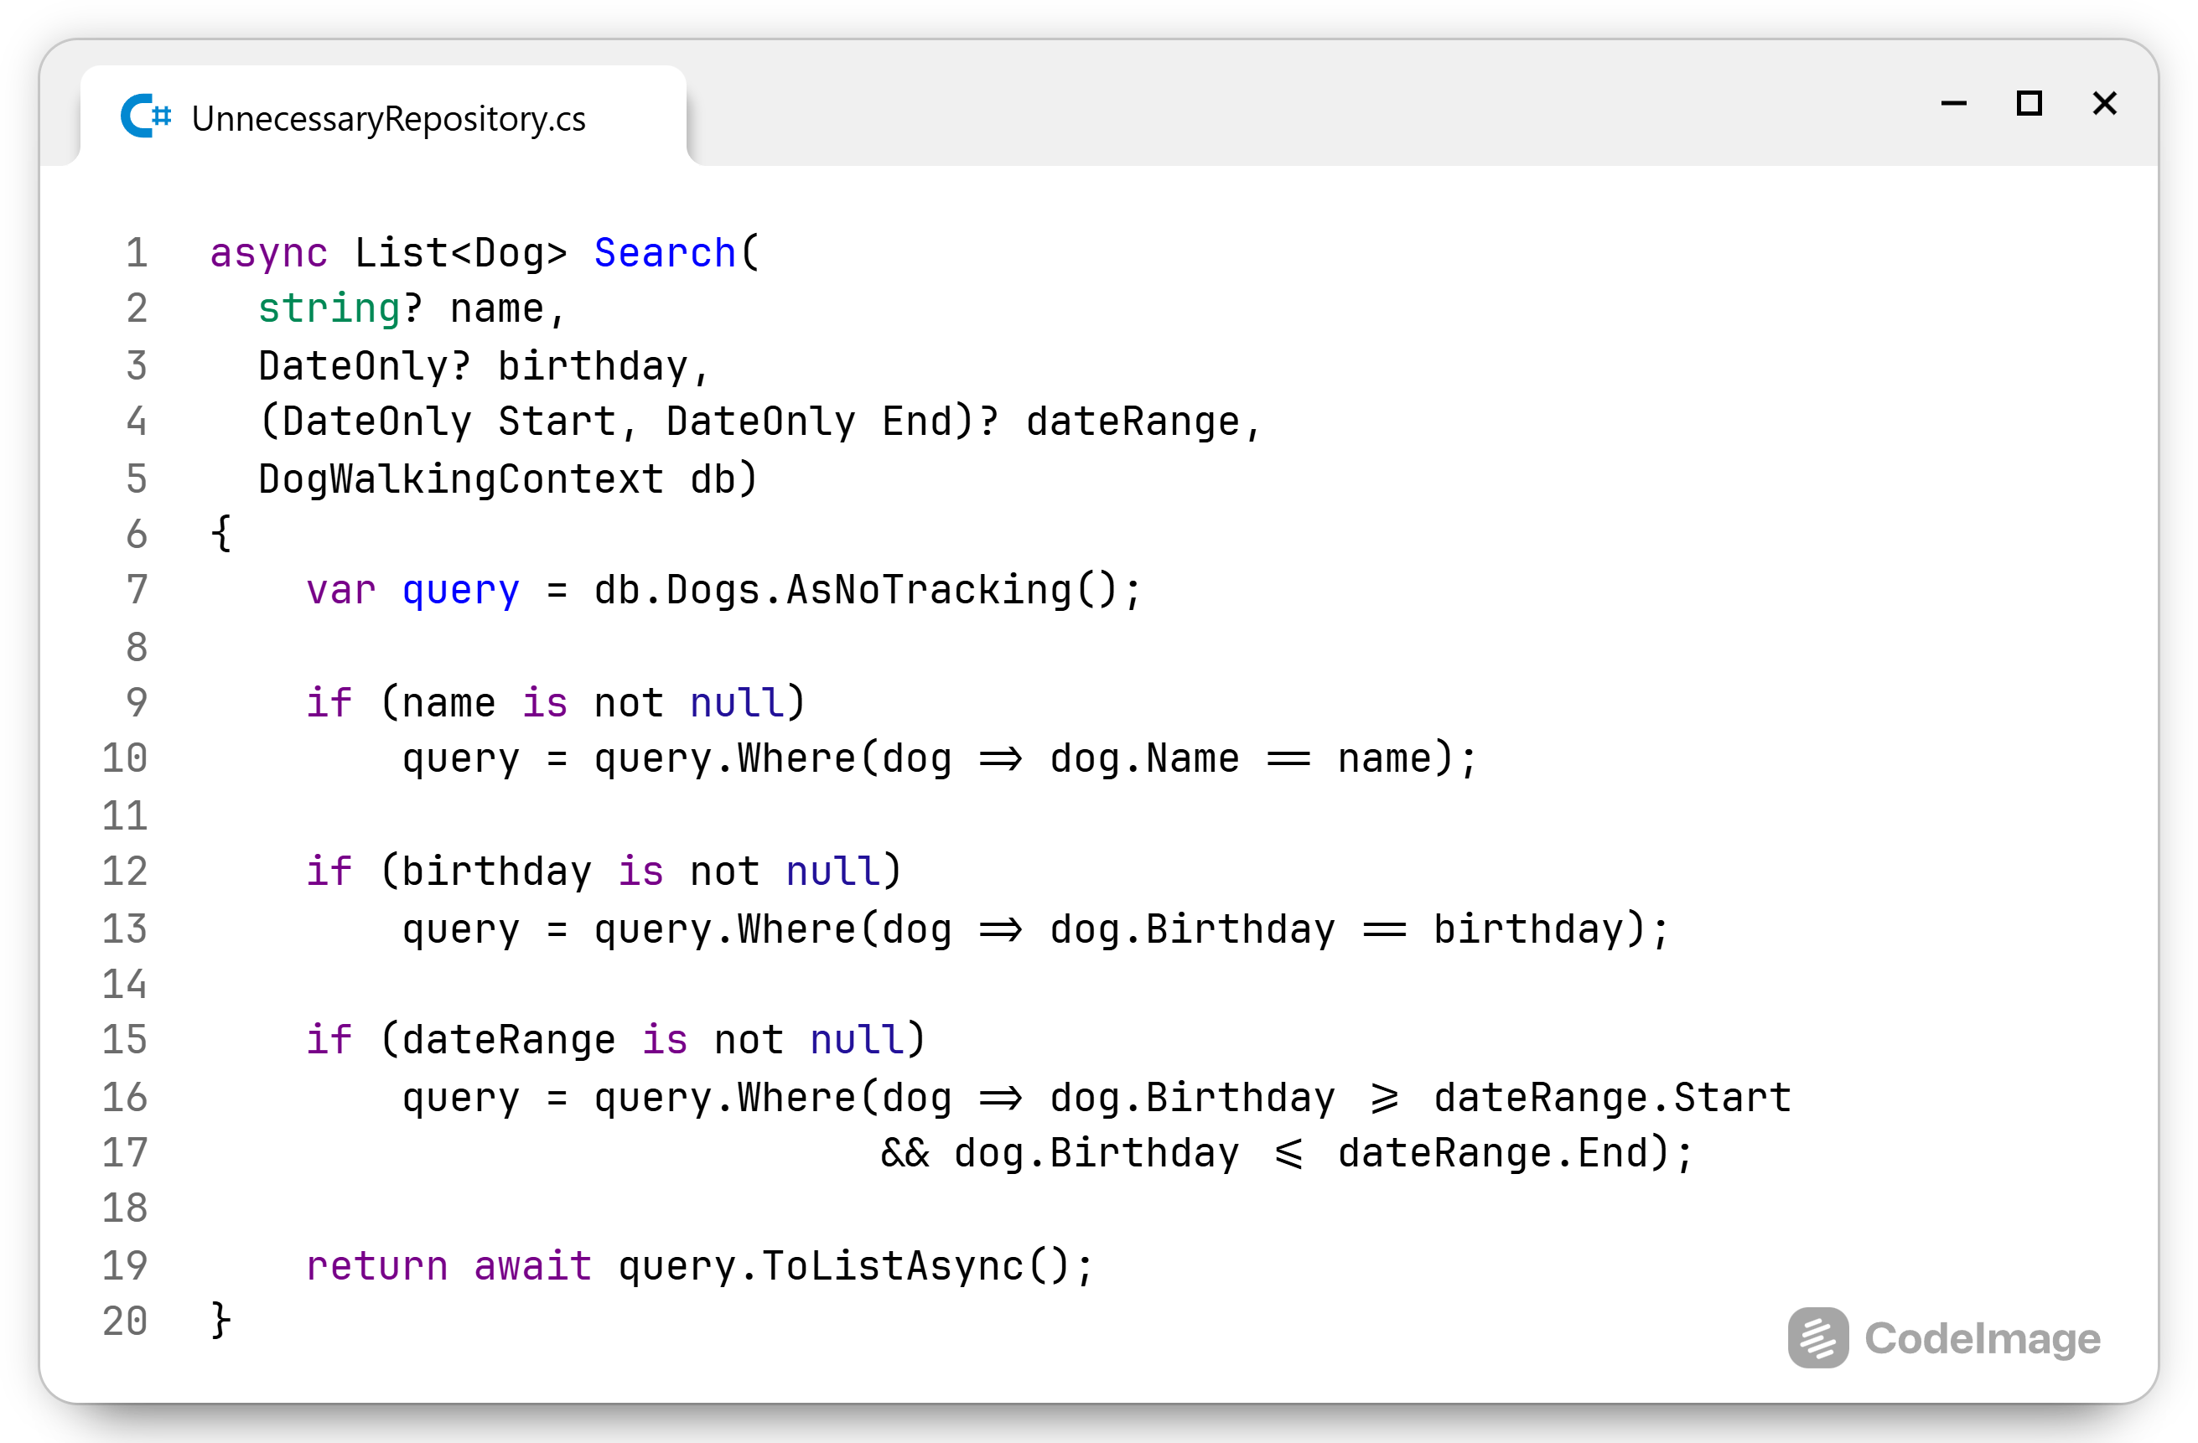
Not like this ⚠️
Notes:
This is a god class, after a while the combinations will become overly complex that no one can find their way in them
This should be 3 separate queries
The only exception is a search endpoint for an overview page

Slide 14

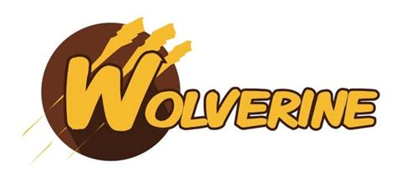
Notes:
You can implement this architecture on your own, but frameworks can make this a lot easier
In the dotnet ecosystem, Wolverine helps you fall into th pit of success, possibly dug by my dog
At it’s core, it’s a messaging framework like MassTransit or NServiceBus
Wolverine goes further however, it can be used to create API endpoints, and it helps you write A-Frame architecture-based applications
It can do so next to existing code and frameworks. I’m going to leave the minimal API in place and use Wolverine for the more complex examples
It’s handlers expect a combination of 3 methods to be present:
Load/LoadAsync: infrastructure
Validate: quality of life improvement
Handle: logic

Slide 15
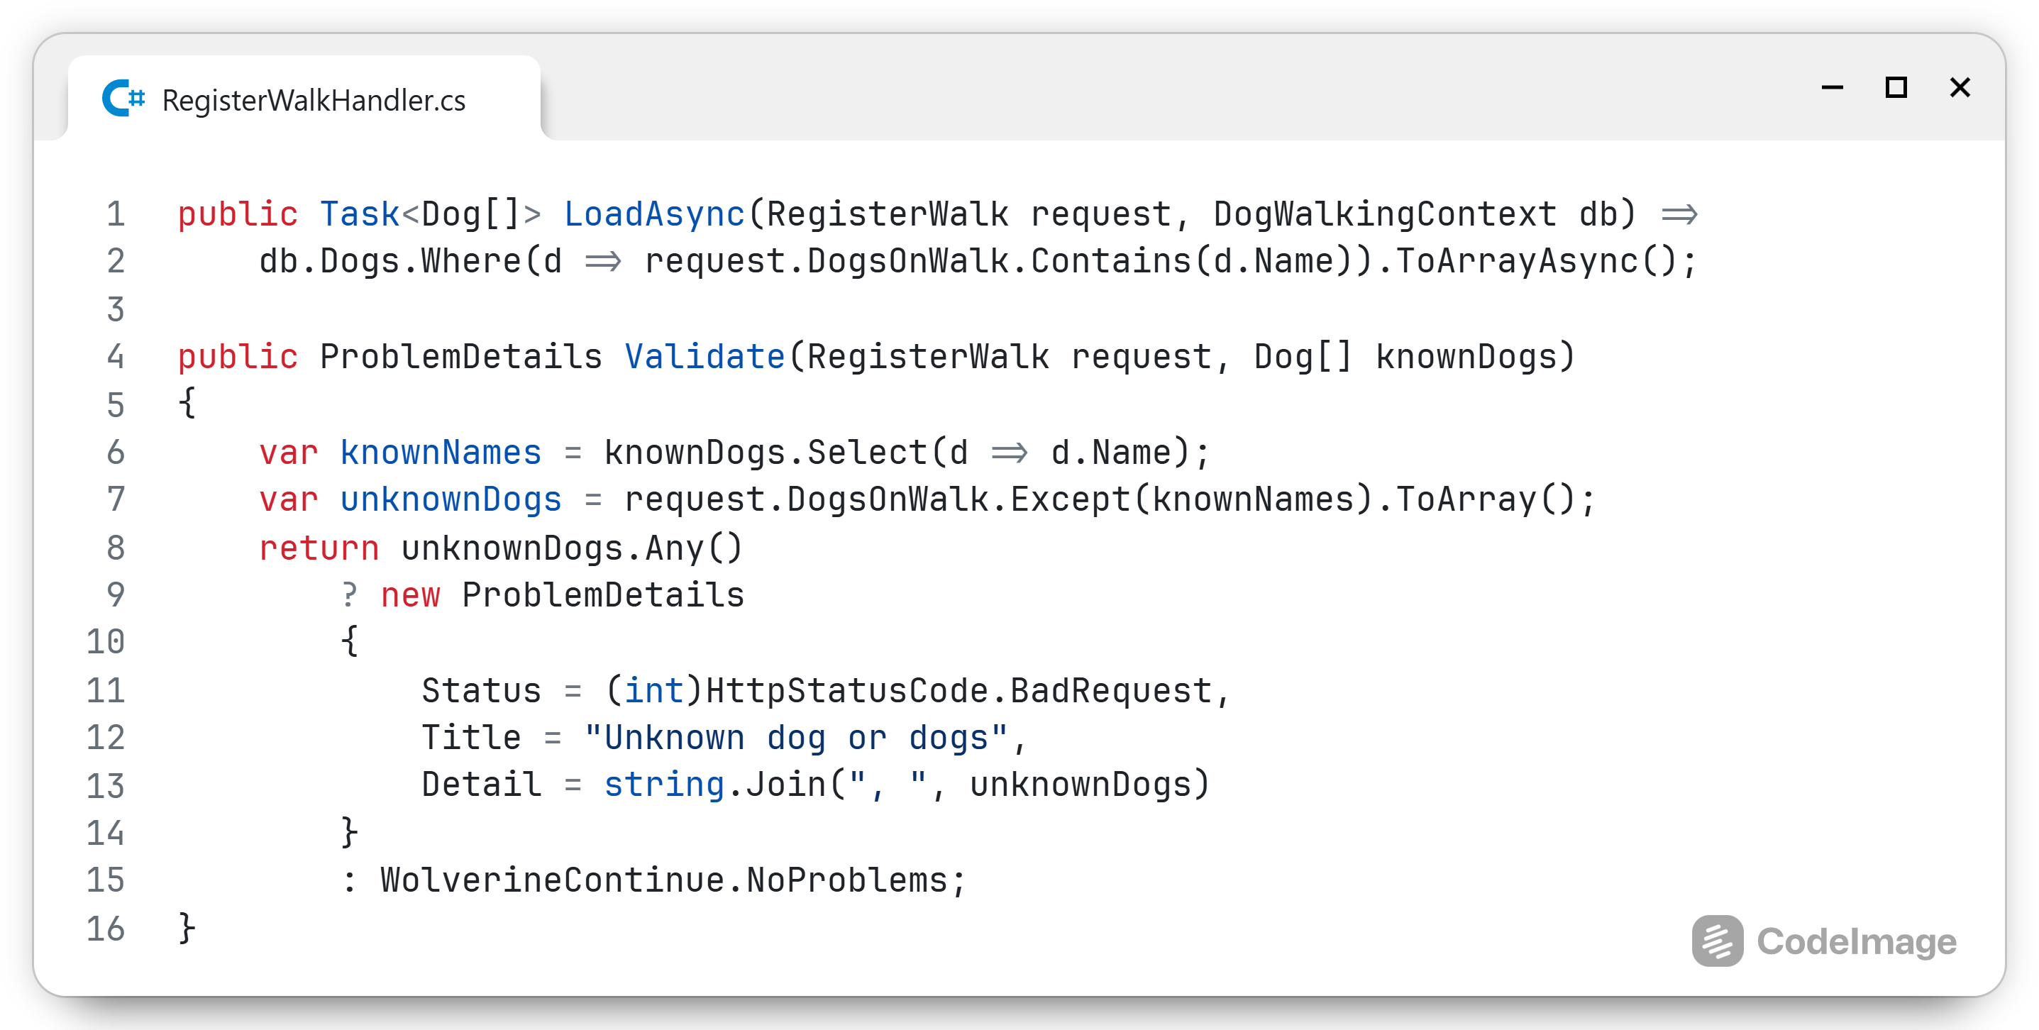
Notes:
In this code, I’m going to add a walk into the system
First thing I need are the dogs that go on the walk
Injection happens by inspecting the method signature
Wolverine can find a lot of data and services from query params, headers, context, dependency injection, etc.
I load them all from the database based on their name
Then I validate that all dogs are registered in the system
Notice how the result of the Load function can be passed into the Validate function

Slide 16
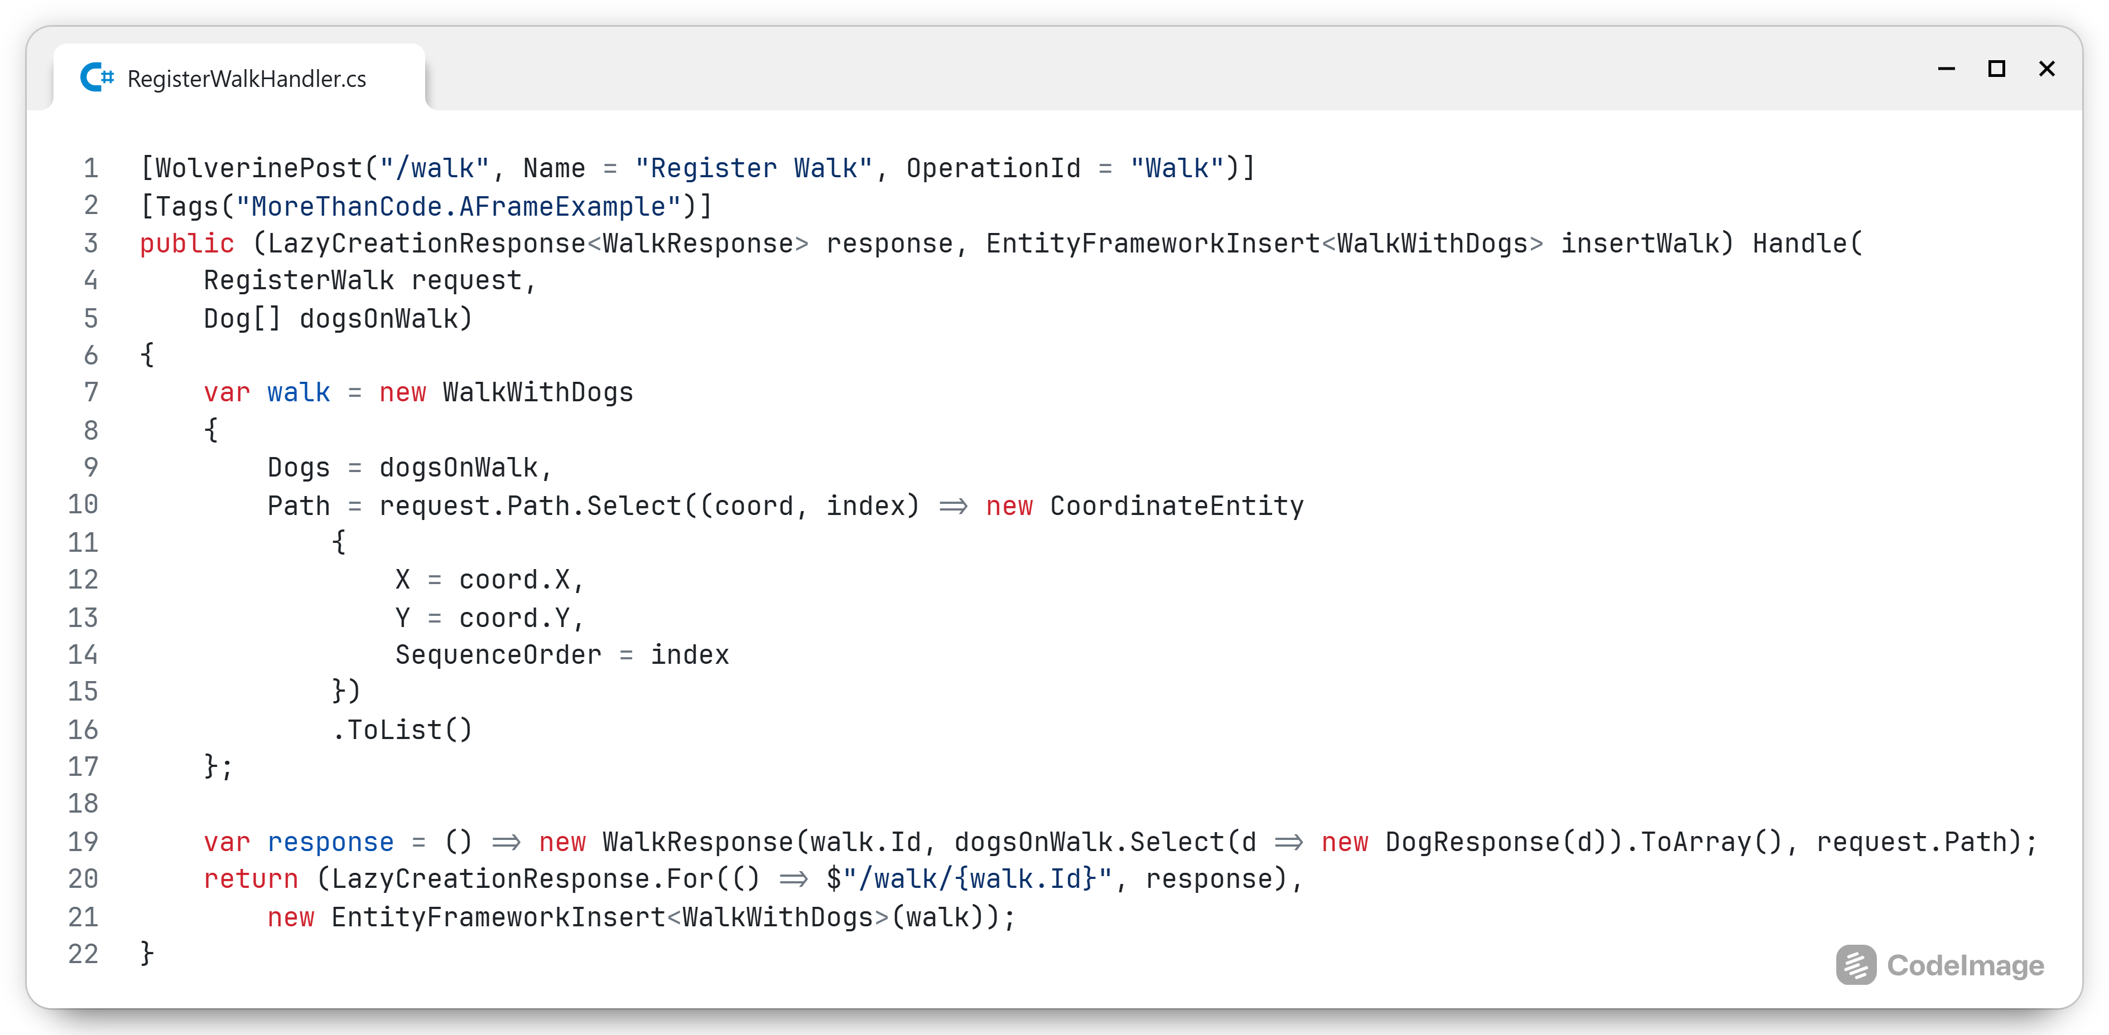
Notes:
This is the entire Handle function
Although small, it has a lot going on, let’s take a look at each different part

Slide 17
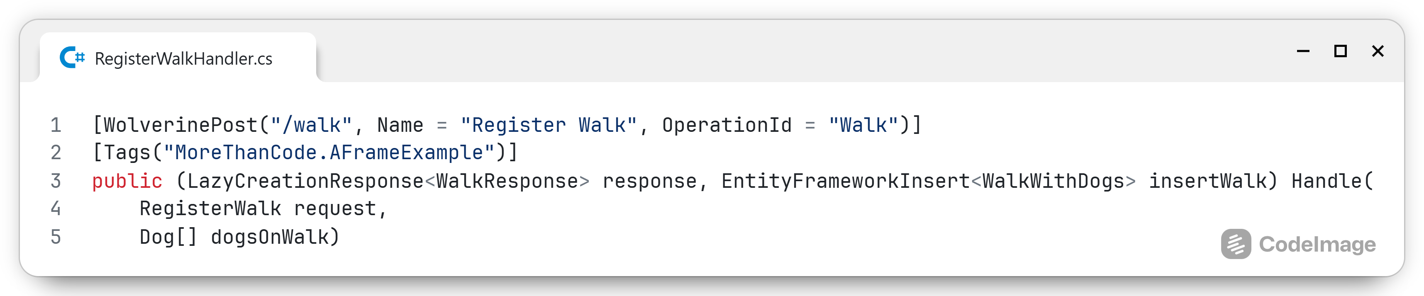
Method signature
Notes:
The WolverinePost and Tag attributes help identify that this is an HTTP endpoint
Those attributes, together with the method signature, include all the details needed to generate the OpenAPI documentation
The return tuple describes the decisions that are going to come from the logic inside this handler
The input of this function can be several objects, from the command in the body of the HTTP request or the message from the bugs, to data from the Load method and so much more as I’ll cover shortly

Slide 18
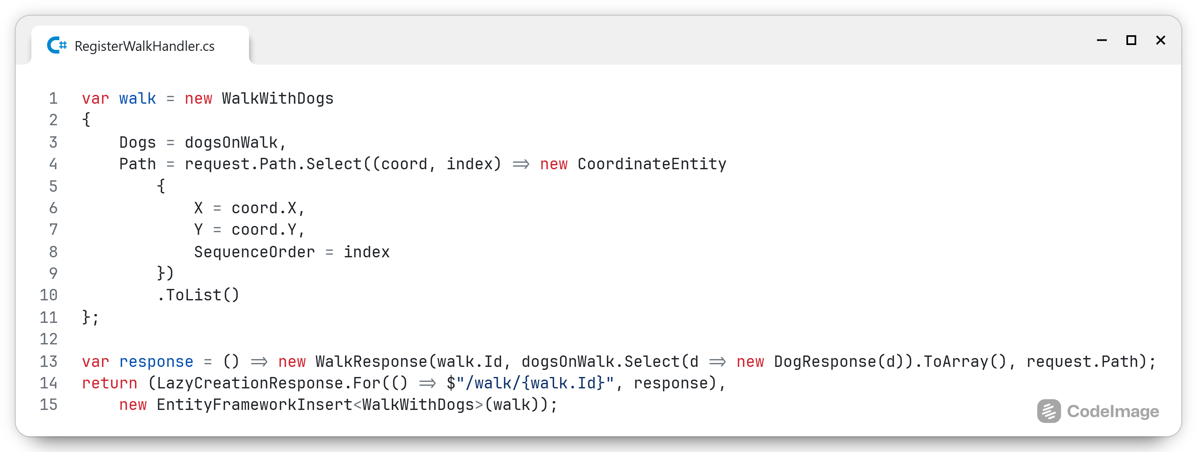
The body
Notes:
Because the validation is handled, I can trust that this is a good walk and I can just create it
Calling straight into infrastructure code is not done, so instead I return a LazyCreationResponse and an insert side effect
Return tuples from HTTP and message handlers can contain multiple items
The first is the response to the client, this will be a 201 – CREATED
I’m wrapping this into a lazy object as the id is not known at this time
The side effect needs to be executed first

Slide 19
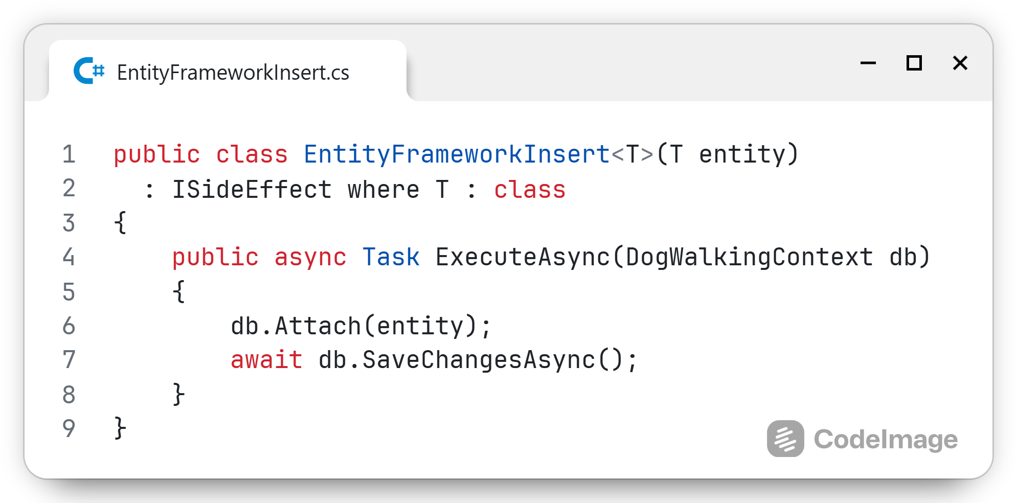
Side effect
Infrastructure operation
Reusable
Returned explicitly
Executed as part of the transaction of the request
Intended for database and file system operations
Notes:
Because the validation is handled, I can trust that this is a good walk and I can just create it
Calling straight into infrastructure code is not done, so instead I return a LazyCreationResponse and an insert side effect
Return tuples from HTTP and message handlers can contain multiple items
The first is the response to the client, this will be a 201 – CREATED
I’m wrapping this into a lazy object as the id is not known at this time
The side effect needs to be executed first

Slide 20
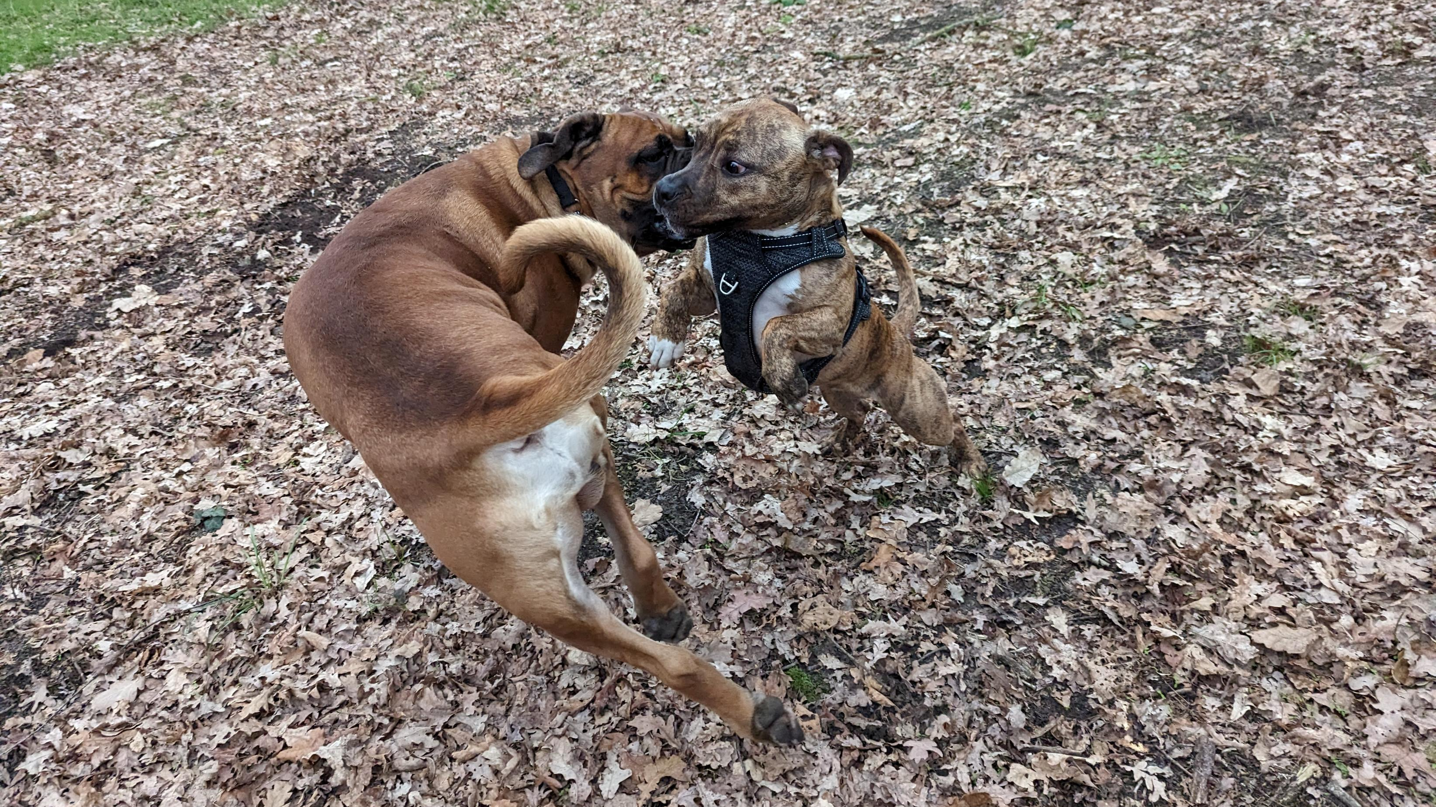
Notes:
Simple scenarios only go so far, let’s look at a more complex scenario
During walks, we’re going to meet friends: new and old
After the walk, I want to get an overview of all of them so I can remember all the fun interactions

Slide 21
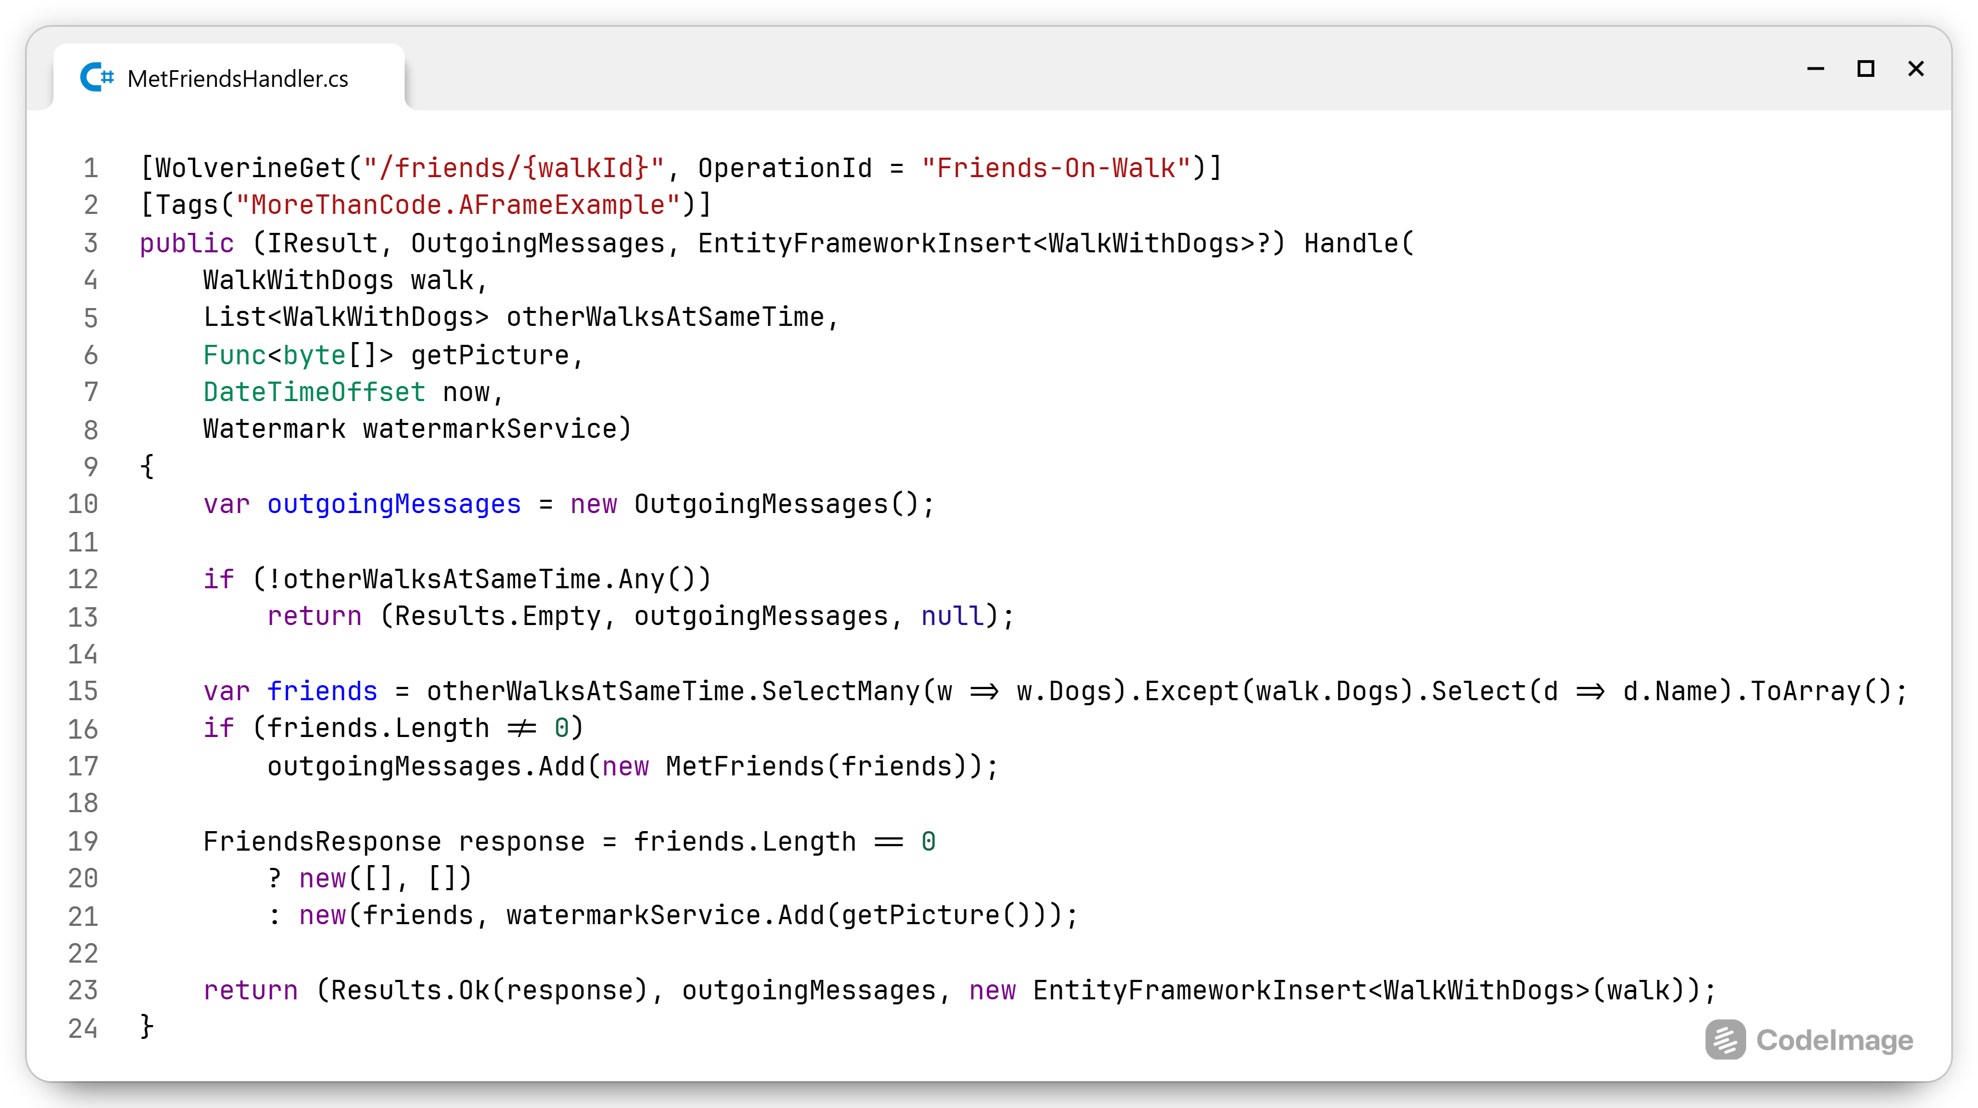
Notes:
Let me start with the logic of this one, it’ll make the infrastructure easier to understand
I’m injecting:
The walk I was on
Other walks at the same time
A function to get a picture
The current date: spoiler, this isn’t used, just here to show that I don’t need DateTimeOffset.Now inside my logic, same goes for guids or random numbers. Don’t generate them inside logic code, pass them in
The watermark service injected from DI
First special case here is the OutgoingMessages: all messages in this collection object will be published to the bus after all transactions (side effects) have completed
Use durable messaging (in- and outbox patterns) to ensure messages are persisted as part of the transaction and thus everything succeeds or fails together
Then the getPicture Func, in the case that loading of infrastructure takes a long time and it’s not guaranteed to be used
Use a Func to act as a easy to stub infrastructure alternative, still easy to:
Test
Replace
Notice that I’m explicitly passing the EF Insert and not the generic ISideEffect interface

Slide 22

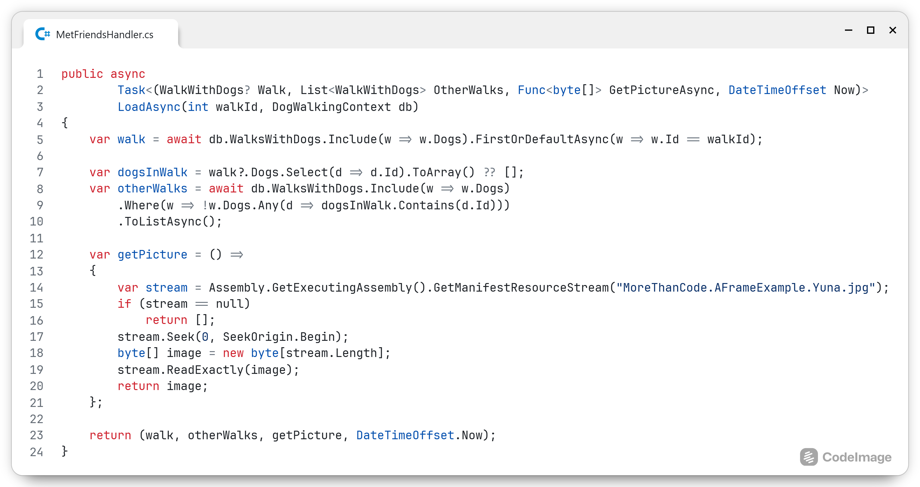
Notes:
Wolverine gets the walkId from the url parameter and the DbContext from DI
I load the walk and other walks that are not my own
Here the load image gets an actual implementation to load the real picture, this can be parameterised should I need to pass in the name of the picture
Wolverine can pass each item independently on to subsequent Validate and Handle methods, so I have a lot of flexibility with the data
I.e. Validate needs only the walk and the date, then it can just ask for that

Slide 23
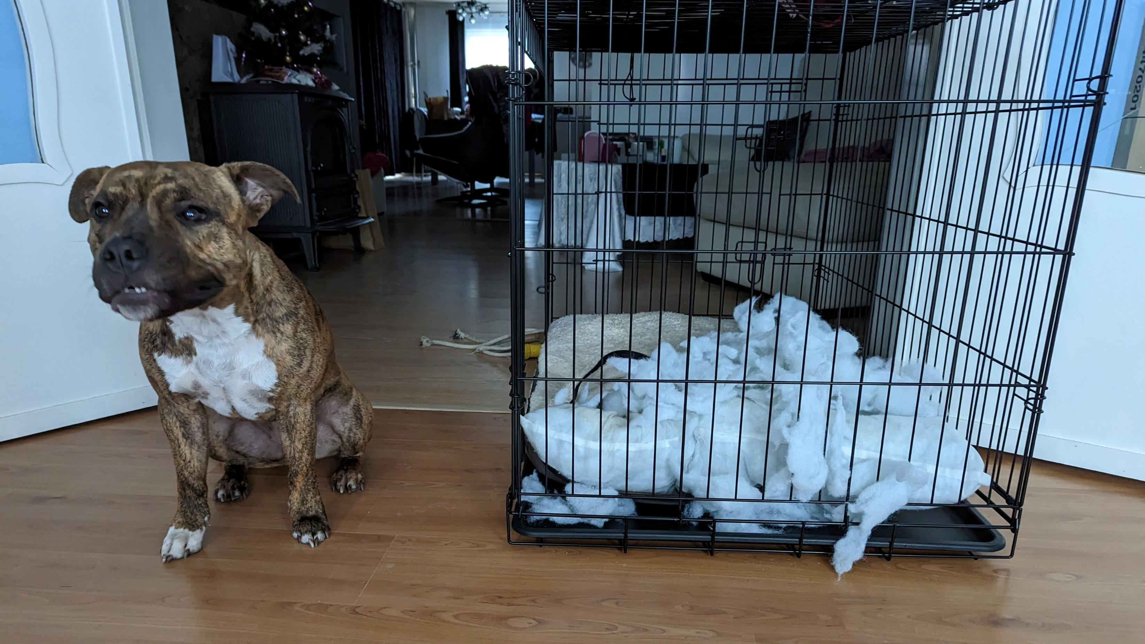
Notes:
We all know pillows can unexpectedly explode while innocent puppies are sleeping on them
The same thing can happen in our systems, things go wrong and blow up in our face
You can find the settings for in- and outbox patterns, retries, error handling and all other resiliency settings that comes with Wolverine
There are side effects for the database and file system operations
But what about exernal systems: calling api’s and webhooks, sending email/sms/etc
Namely, things that can go wrong, but you don’t want to go through your whole business flow again
Use business event or command and have technical handlers process these events

Slide 24
Events
Business Event
Command
MetFriend
Rest of the system needs to know what to listen for
On a new functionality, that part knows what to listen for
Getting an overview of a certain step can be difficult (what parts send email)
SendEmail
Current part of the system needs to know next steps
Easy to resend without triggering other parts of the system
On a new functionality, need to update all places it needs to happen
Notes:
Sending email, calling http endoints, communicating with external systems in general should not be done through side effects
These things can go wrong for several of reasons
And unexpectedly
I don’t want to retry the whole business logic if I know I just need to try resending the email
That is why I send a business event to be handled by a technical handler
When this fails after resiliency, a simple command can trigger the same part

Slide 25
Technical Handlers
Handles an event
Possibly a command as well
Part of the infrastructure code
Can be restarted or retried when fails

Slide 26
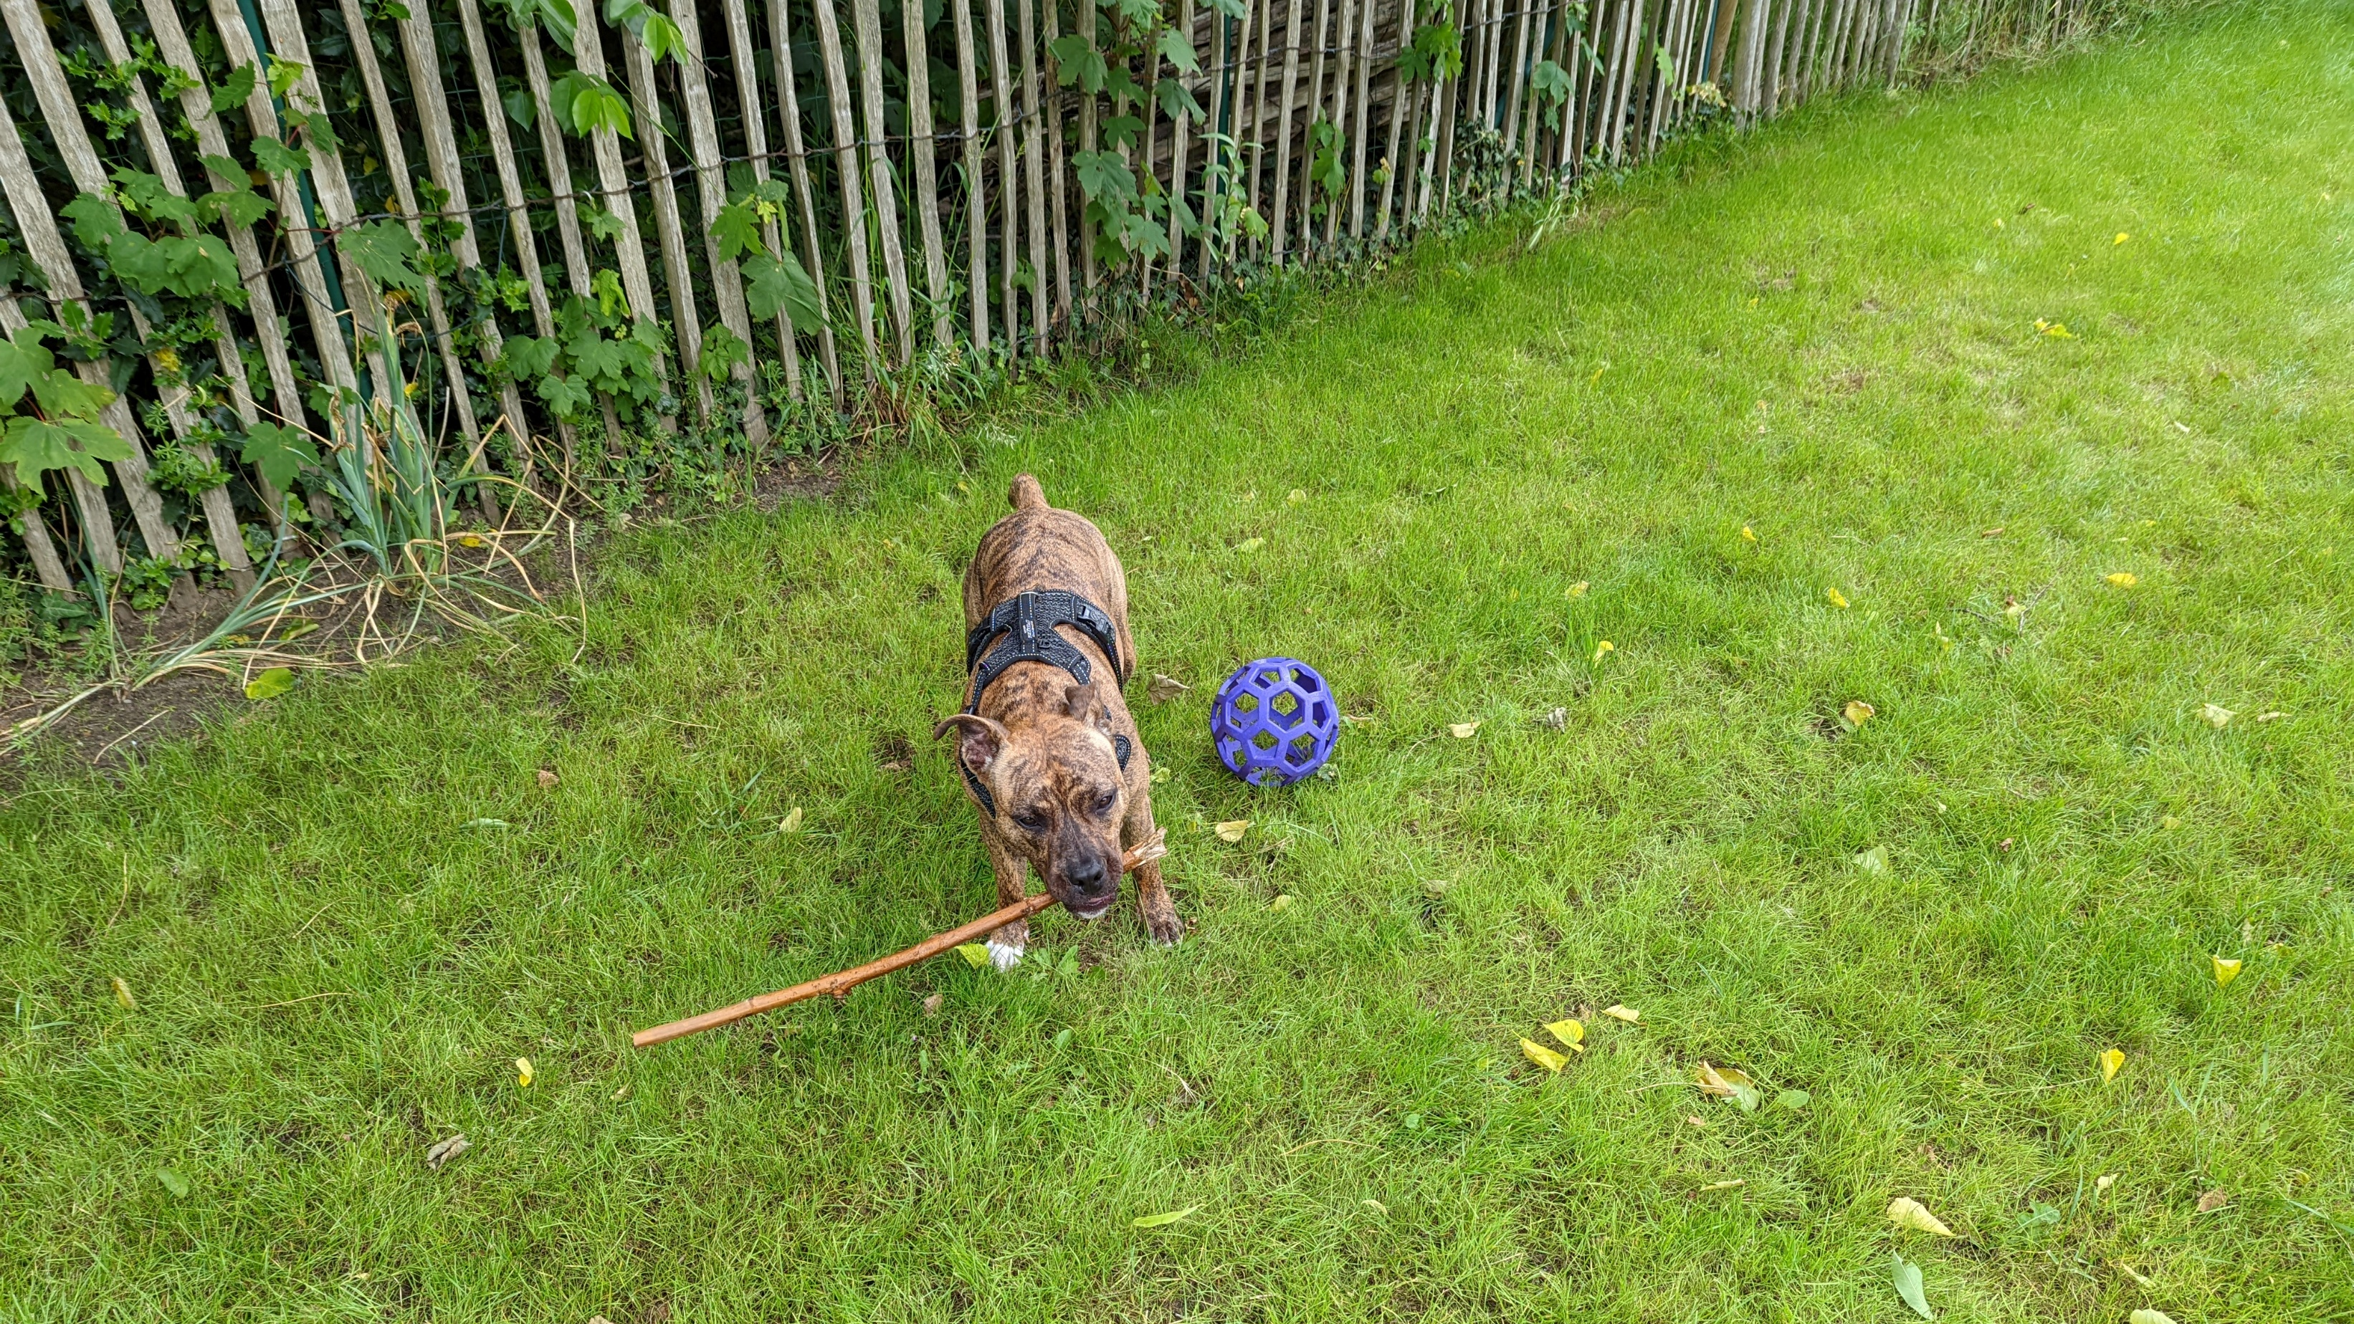
Notes:
Here we can see my dog testing the strength of this stick
And just like her, I need to test my application
With A-Frame architecture, I can simplify my tests
Logic will be tested with unit tests
Infrastructure will be tested with integration tests

Slide 27
Testing logic
Unit tests
No need for stubbing/mocking
Assertions on results
Test special cases
Use overlapping tests

Slide 28
Testing infrastructure
Integration tests
Start database
Write to file system
Have fake external systems send real responses
Test most occurring scenarios

Slide 29
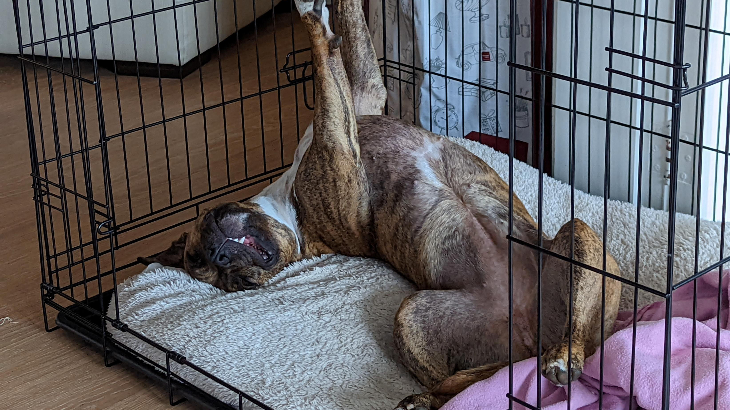
The End
Notes:
Now that I’ve separated infrastructure and logic
That my tests are a lot simpler and, in many cases, faster
Now that my code is more maintainable, readable and testable
I can relax just like my dog

Slide 30

GitHub Repo
https://github.com/KenBonny/A-Frame-Mazing-Architecture

